Slide 1
Project Portal
Iteration 2 Review

Slide 2
Project Summary
A website that aims to create a common repository of projects created by Boston University Students and Faculty
Create an Account and start a project
Link your teammates to a given project
An easy way to see similar projects done by previous semesters
Track your projects during your scholastic career

Slide 3
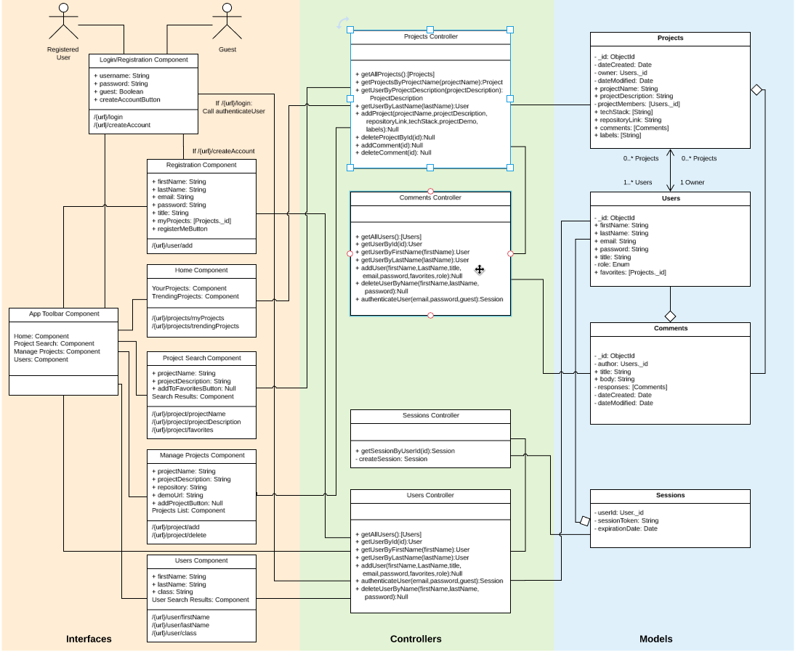
Architecture
RESTful MVC

Slide 4
Defects Status
Affected Areas | Iter 1 Reported | Iter 1 Fixed | Iter 2 Reported | Iter 2 Fixed
User Interfaces | N/A | N/A | 10 | 0
Controllers | N/A | N/A | 9 | 6
Models | N/A | N/A | 0 | 0
Routes | N/A | N/A | 1 | 0
Other | N/A | N/A | 1 | 1

Slide 5
Test Case Management and Automation Update
Test Case Management | Iteration 1 | Iteration 2 | Iteration 3
Number of Test cases Added | 8 | 22 | 24
Number of Test cases Executed | 8 | 22 | 24
Pass | 8 | 19
Fail | 0 | 3
Pass Percentage | 100% | 86%
Automation Update
API Automation | 3 | 17
UI Automation | 0 | 2

Slide 6
Product Complexity
Product Complexity: | Iteration 1 | Iteration 2 | Iteration 3 | Iteration 4
Lines of Code (LOC) The total number of lines of code in the application |  | 33076
Number of Files The total number of classes or functions in the entire application
Number of classes: The total number of classes or functions in the entire application
Number of methods The total number of methods in the application

Slide 7
Testing Metrics and Project Cost
Process Metrics: | Iteration 1 | Iteration 2 | Iteration 3
Team Velocity This measures the number of User Stories the team complete in an Iteration | 8 | 15
Open/Close Rates This measures the number of Defects reported in a sprint | 1 | 12
Active Days This is a measure of the time a team spends contributing to the product development cycle | 6 | 8
QA kickback rate Number of defects that were re-opened by QA in an Iteration | 0 | 0
Product Cost: Man Hours | 100 | 145

Slide 8
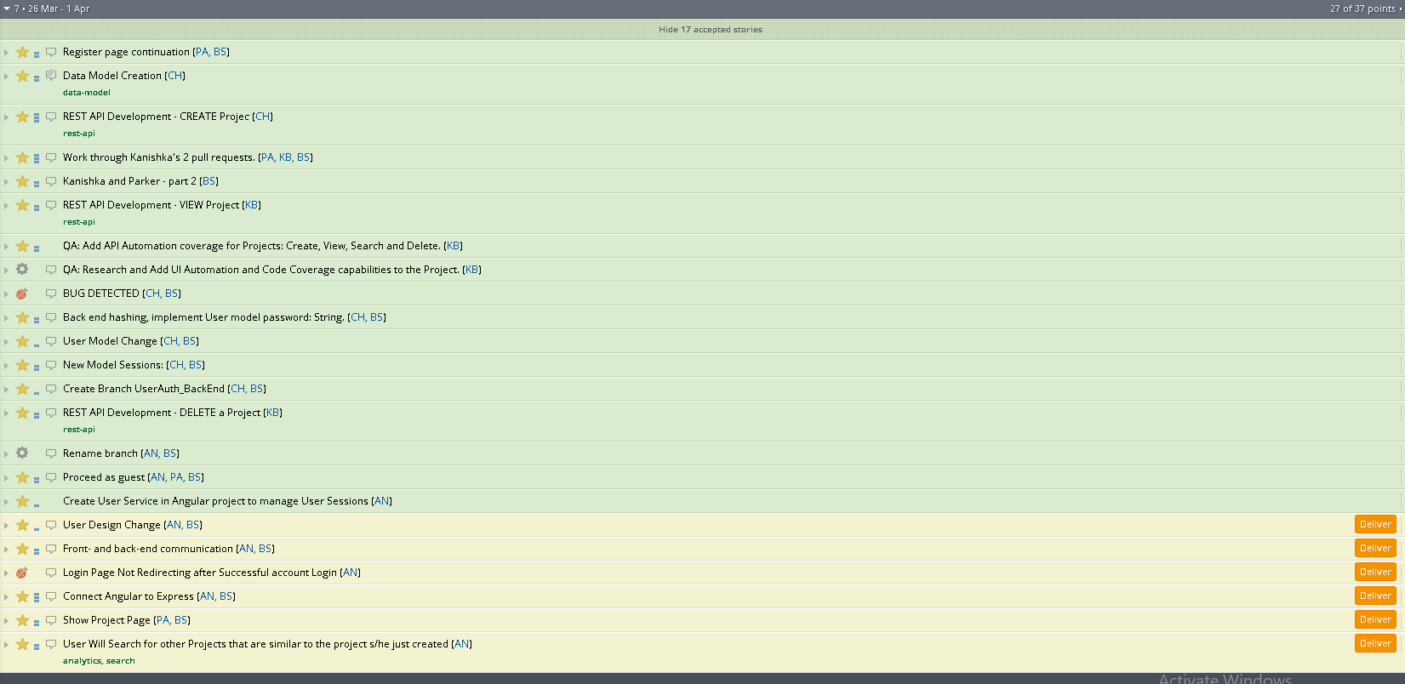
Our activity

Slide 9
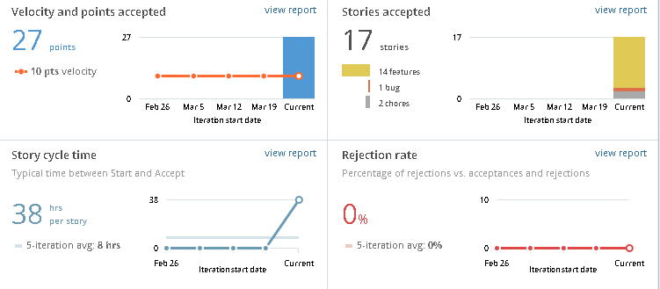
Burndown
17/23 stories

Slide 10
Key Highlights of the Sprint
User Authentication & Session Management
Implemented password hashing using sha256 hashing algorithm.
Implemented session state management.
UI Enhancements/Changes
Updated Login Page.
New ‘Create Account’ page.
Redirection between pages is working now.
Guest login implemented
Display project (design) implemented.

Slide 11
Test Coverage and automation
API Tests | Back End
Total tests added | 22
Tests Passed | 20
Tests Failed | 2
UI Tests
Total tests added | 2
Tests Passed | 2
Tests Failed | 0

Slide 12
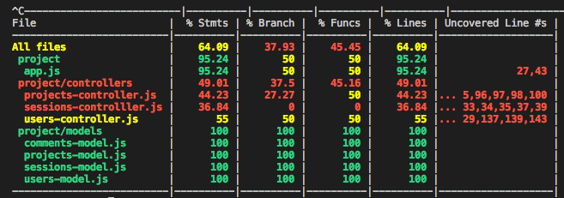
Test Coverage and automation
Coverage Report

